Slide 1
Unsupervised learning
K Means Clustering

Slide 2
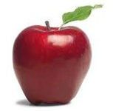
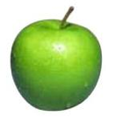
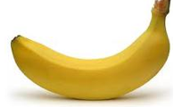
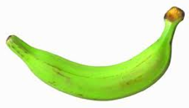
Supervised learning
label
label₁
model/
predictor
label₃
label₄
label₅
Supervised learning: given labeled examples

Slide 3
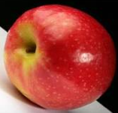
Unsupervised learning
Unupervised learning: given data, i.e. examples, but no labels

Slide 4
Unsupervised learning
Given some example without labels, do something!

Slide 5
Unsupervised learning applications
learn clusters/groups without any label
customer segmentation (i.e. grouping)
image compression
bioinformatics: learn motifs
find important features
…

Slide 6
Unsupervised learning: clustering
Raw data
features
f₁, f₂, f₃, …, f_{n}
f₁, f₂, f₃, …, f_{n}
Clusters
f₁, f₂, f₃, …, f_{n}
f₁, f₂, f₃, …, f_{n}
group into classes/clusters
extract
features
f₁, f₂, f₃, …, f_{n}
No “supervision”, we’re only given data and want to find natural groupings

Slide 7
Unsupervised learning: modeling
Most frequently, when people think of unsupervised learning they think clustering
Another category: learning probabilities/parameters for models without supervision
Learn a translation dictionary
Learn a grammar for a language
Learn the social graph

Slide 8
Clustering
Clustering: the process of grouping a set of objects into classes of similar objects
Applications?

Slide 9
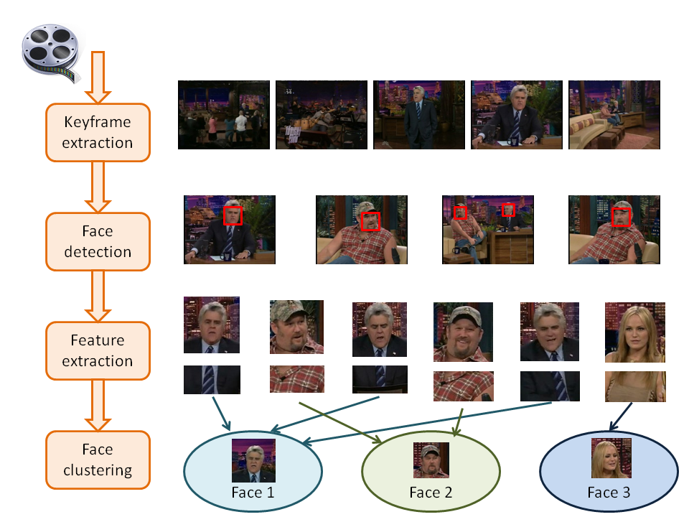
Face Clustering

Slide 10
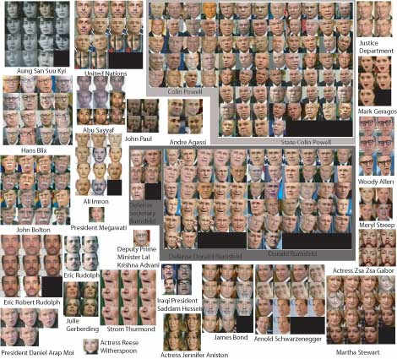
Face clustering

Slide 11
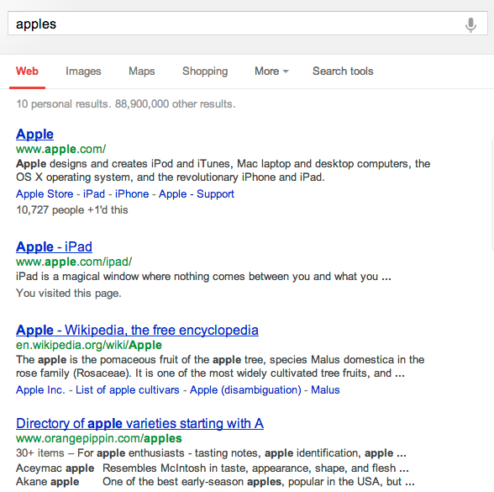
Search result clustering

Slide 12
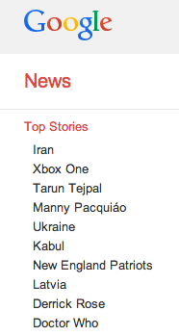
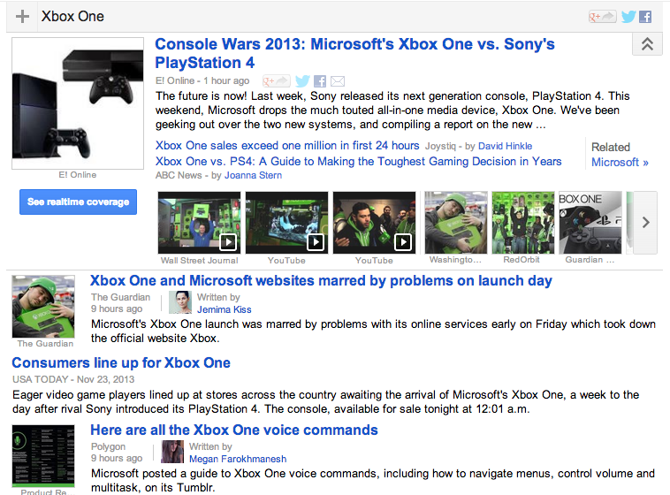
Google News

Slide 13
Issues for clustering
Representation for clustering
How do we represent an example
features, etc.
Similarity/distance between examples
Flat clustering or hierarchical
Number of clusters
Fixed a priori
Data driven?

Slide 14
Clustering Algorithms
Flat algorithms
Usually start with a random (partial) partitioning
Refine it iteratively
K means clustering
Model based clustering
Spectral clustering
Hierarchical algorithms
Bottom-up, agglomerative
Top-down, divisive

Slide 15
Hard vs. soft clustering
Hard clustering: Each example belongs to exactly one cluster
Soft clustering: An example can belong to more than one cluster (probabilistic)
Makes more sense for applications like creating browsable hierarchies
You may want to put a pair of sneakers in two clusters: (i) sports apparel and (ii) shoes

Slide 16
K-means
Most well-known and popular clustering algorithm:
Start with some initial cluster centers
Iterate:
Assign/cluster each example to closest center
Recalculate centers as the mean of the points in a cluster

Slide 17
K-means: an example

Slide 18
K-means: Initialize centers randomly

Slide 19
K-means: assign points to nearest center

Slide 20
K-means: readjust centers

Slide 21
K-means: assign points to nearest center

Slide 22
K-means: readjust centers

Slide 23
K-means: assign points to nearest center

Slide 24
K-means: readjust centers

Slide 25
K-means: assign points to nearest center
No changes: Done

Slide 26
K-means
Iterate:
Assign/cluster each example to closest center
Recalculate centers as the mean of the points in a cluster
How do we do this?

Slide 27
K-means
Iterate:
Assign/cluster each example to closest center
Recalculate centers as the mean of the points in a cluster
iterate over each point:
- get distance to each cluster center
- assign to closest center (hard cluster)

Slide 28
K-means
Iterate:
Assign/cluster each example to closest center
Recalculate centers as the mean of the points in a cluster
iterate over each point:
- get distance to each cluster center
- assign to closest center (hard cluster)
What distance measure should we use?

Slide 29
Distance measures
Euclidean:
good for spatial data

Slide 30
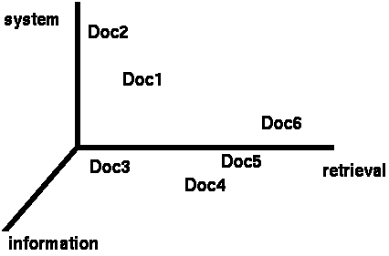
Clustering documents (e.g. wine data)
One feature for each word. The value is the number of times that word occurs.
Documents are points or vectors in this space

Slide 31
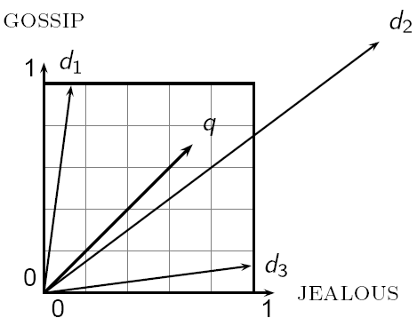
When Euclidean distance doesn’t work
Which document is closest to q using Euclidian distance?
Which do you think should be closer?

Slide 32
Issues with Euclidian distance
the Euclidean distance between q and d₂ is large
but, the distribution of terms in the query q and the distribution of terms in the document d₂ are very similar
This is not what we want!

Slide 33
cosine similarity
correlated with the angle between two vectors

Slide 34
cosine distance
cosine similarity is a similarity between 0 and 1, with things that are similar 1 and not 0
We want a distance measure, cosine distance:
good for text data and many other “real world” data sets
is computationally friendly since we only need to consider features that have non-zero values both examples

Slide 35
K-means
Iterate:
Assign/cluster each example to closest center
Recalculate centers as the mean of the points in a cluster
Where are the cluster centers?

Slide 36
K-means
Iterate:
Assign/cluster each example to closest center
Recalculate centers as the mean of the points in a cluster
How do we calculate these?

Slide 37
K-means
Iterate:
Assign/cluster each example to closest center
Recalculate centers as the mean of the points in a cluster
Mean of the points in the cluster:
where:

Slide 38
K-means loss function
K-means tries to minimize what is called the “k-means” loss function:
that is, the sum of the squared distances from each point to the associated cluster center

Slide 39
Minimizing k-means loss
Iterate:
1. Assign/cluster each example to closest center
2. Recalculate centers as the mean of the points in a cluster
Does each step of k-means move towards reducing this loss function (or at least not increasing)?

Slide 40
Minimizing k-means loss
Iterate:
1. Assign/cluster each example to closest center
2. Recalculate centers as the mean of the points in a cluster
Does this mean that k-means will always find the minimum loss/clustering?

Slide 41
Minimizing k-means loss
Iterate:
1. Assign/cluster each example to closest center
2. Recalculate centers as the mean of the points in a cluster
NO! It will find a minimum.
Unfortunately, the k-means loss function is generally not convex and for most problems has many, many minima
We’re only guaranteed to find one of them

Slide 42
K-means variations/parameters
Start with some initial cluster centers
Iterate:
Assign/cluster each example to closest center
Recalculate centers as the mean of the points in a cluster
What are some other variations/parameters we haven’t specified?

Slide 43
K-means variations/parameters
Initial (seed) cluster centers
Convergence
A fixed number of iterations
partitions unchanged
Cluster centers don’t change
K!

Slide 44
K-means: Initialize centers randomly
What would happen here?
Seed selection ideas?

Slide 45
Seed choice
Results can vary drastically based on random seed selection
Some seeds can result in poor convergence rate, or convergence to sub-optimal clusterings
Common heuristics
Random centers in the space
Randomly pick examples
Points least similar to any existing center (furthest centers heuristic)
Try out multiple starting points
Initialize with the results of another clustering method

Slide 46
Furthest centers heuristic
μ₁ = pick random point
for i = 2 to K:
μ_{i} = point that is furthest from any previous centers
point with the largest distance to any previous center
smallest distance from x to any previous center

Slide 47
K Means Clustering Example Problem
https://www.gatevidyalay.com/tag/k-means-clustering-example-ppt/

Slide 48
What is K ++ means?
K-means++ is a smart centroid initialization method for the K-mean algorithm.
The goal is to spread out the initial centroid by assigning the first centroid randomly then selecting the rest of the centroids based on the maximum squared distance. The idea is to push the centroids as far as possible from one another.

